Slide 1
Music Genre Classification using Convolutional Neural Networks & Machine Learning Classifiers
Islam Anwar

Slide 2
Agenda
Introduction
Concept of sound and music
Related Work
Proposed Methodology
Model Overview
Feature Extraction
Proposed Model
Traditional Classifiers
Dataset
Evaluation Metrics
Results & Discussion

Slide 3

Introduction
During the recent research performed on MIR, of the 104 papers, approximately half displayed quantitative results and over 80% of those papers reported mean values of performance measure.
Genre classification is at the forefront of research for audio streaming services and other industries
Perform genre classification on a collection of audio samples
Deploying machine learning & deep learning techniques to classify audio files

Slide 4
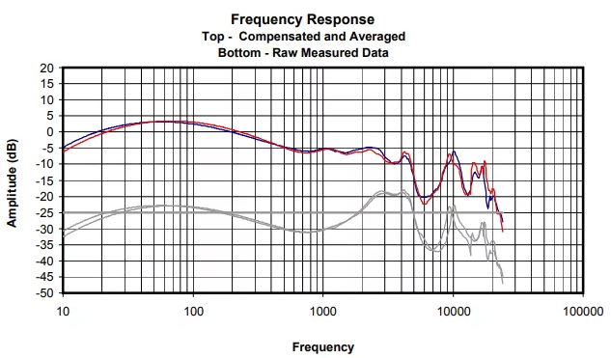
Sound and relation to music
Sound is a wave sequence
Pitch, frequency, amplitude, etc.
Analyzing audio signatures to showcase musical characteristics

Slide 5
Related Work

Slide 6
Related Works
Short Time Fourier Transform with different window types, window sizes & overlap ratios (Elbir, 2018).
Extracting different features like time and frequency domain features (Elbir, 2018).
Using CNN and traditional classifiers (Ramirez, 2020)
(Chillara, 2019) contributed other models like Logistic Regression and Artificial Neural Networks
H. Bahuleyan suggested two methodologies, using spectrograms & hand-crafted features to be fed to models (Bahuleyan, 2018).

Slide 7
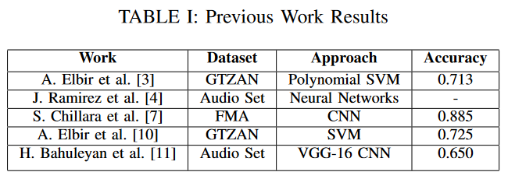
Comparison of Related Works

Slide 8
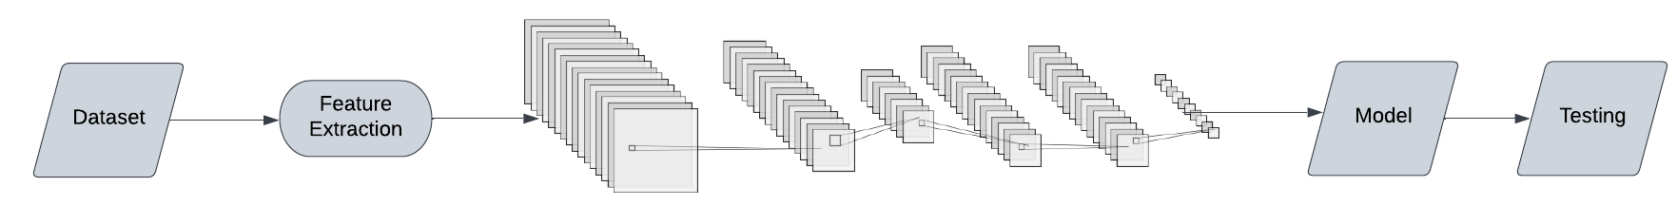
Proposed Methodology Overview

Slide 9
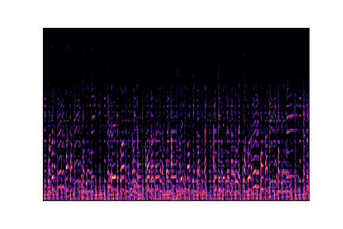
Feature Extraction
Extracting spectrogram
From spectrogram, we extract Mel-Frequency Cepstral Coefficients (MFCC) and others.
Expected value & variance of time & frequency domain features (spectral bandwidth, rolloff etc.)

Slide 10
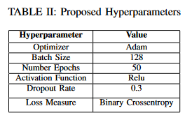
Proposed Model
Convolutional Neural Network
Architecture:
Conv2D layers
MaxPooling2D layers
Dropout
Dense layers

Slide 11
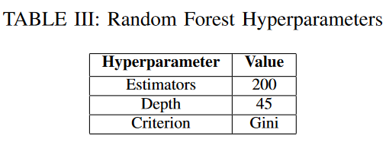
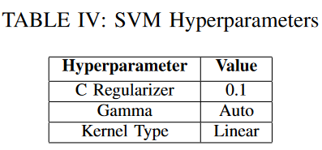
Supervised Classifiers
Support Vector Machines
Random Forest
XGB
XGB + Random Forest + SVM
Hyperparameters for XGB:
1000 Estimators
Learning rate at 0.05

Slide 12
GTZAN Dataset
1000 Observations
10 Genres with 100 observations per genre
Consists of .wav files and .csv files

Slide 13
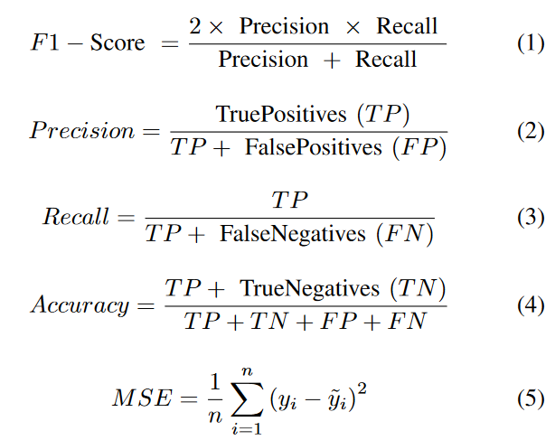
Evaluation Metrics

Slide 14
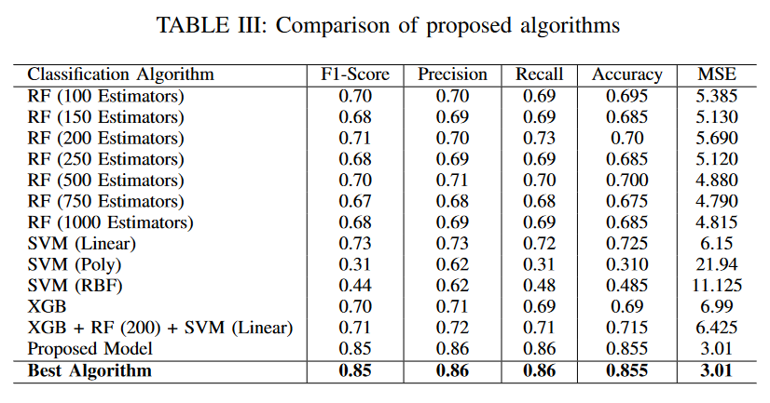
Results Analysis

Slide 15
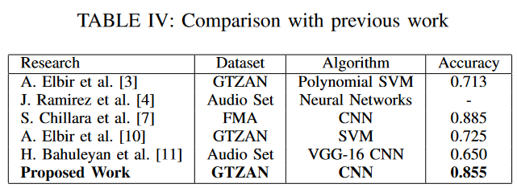
Comparison with other networks

Slide 16
Thank you!
Questions?

Slide 17
References
1] M. Chaudhury, A. Karami, and M. A. Ghazanfar, “Large-scale music genre analysis and classification using machine learning with apache spark,” Electronics, vol. 11, no. 16, p. 2567, 2022.
[2] D. S. Lau and R. Ajoodha, “Music genre classification: A compar- ative study between deep learning and traditional machine learning approaches,” in Proceedings of Sixth International Congress on Infor- mation and Communication Technology, pp. 239–247, Springer, 2022.
[3] A. Elbir, H. O. ̇Ilhan, G. Serbes, and N. Aydın, “Short time fourier transform based music genre classification,” in 2018 Electric Electronics, Computer Science, Biomedical Engineerings’ Meeting (EBBT), pp. 1–4, IEEE, 2018.
[4] J. Ram ́ırez and M. J. Flores, “Machine learning for music genre: multifaceted review and experimentation with audioset,” Journal of Intelligent Information Systems, vol. 55, no. 3, pp. 469–499, 2020.
[5] Y. Xu and W. Zhou, “A deep music genres classification model based on cnn with squeeze & excitation block,” in 2020 Asia-Pacific Signal and Information Processing Association Annual Summit and Conference (APSIPA ASC), pp. 332–338, IEEE, 2020.

Slide 18
References
[6] S. Chillara, A. Kavitha, S. A. Neginhal, S. Haldia, and K. Vidyullatha, “Music genre classification using machine learning algorithms: a com- parison,” Int Res J Eng Technol, vol. 6, no. 5, pp. 851–858, 2019.
[7] R. Singhal, S. Srivatsan, and P. Panda, “Classification of music genres using feature selection and hyperparameter tuning,” Journal of Artificial Intelligence and Capsule Networks, vol. 4, no. 3, pp. 167–178, 2022.
[8] N. Ndou, R. Ajoodha, and A. Jadhav, “Music genre classification: A review of deep-learning and traditional machine-learning approaches,” in 2021 IEEE International IOT, Electronics and Mechatronics Conference (IEMTRONICS), pp. 1–6, IEEE, 2021.
[9] A. Elbir, H. B. C ̧ am, M. E. Iyican, B. ̈Ozt ̈urk, and N. Aydin, “Music genre classification and recommendation by using machine learning techniques,” in 2018 Innovations in Intelligent Systems and Applications Conference (ASYU), pp. 1–5, IEEE, 2018.
[10] H. Bahuleyan, “Music genre classification using machine learning tech- niques,” arXiv preprint arXiv:1804.01149, 2018.
[11] H. Bahuleyan, “Music genre classification using machine learning tech- niques,” arXiv preprint arXiv:1804.01149, 2018.

